Slide 1



Log Analyzer
based LogLLM
for VS Code
Group：Git Commit
日期：2025/12/04

Slide 2


01
Project Background and Objectives
目录
02
Core Technical Solution
03
Agile Development Process
04
Testing and Experimental Results
05
Project Outcomes and Future Work

Slide 3

01
Project Background and Objectives

Slide 4
01-Academic Evolution and Bottlenecks in Log AnomalyDetection
The Importance of Logs
System logs serve as the core observational medium for software reliability research, documenting runtimedocumenting runtime states and events to provide critical information for debugging, performanceperformance monitoring, and reliability assurance.
Limitations of Existing Methods
Current log anomaly detection methods face a triple dilemma: cloud-based large models compromise privacycontrol, IDEs lack unified analysis interfaces, and traditional tools struggle with complex logs,making itdifficuttobalanceparsingaccuracanefficnc.
Research Objectives
This research proposes a localized large-model solution based on LogLLM, meeting three stringent criteria:stringent criteria: high parsing performance, zero privacy leakage, and native IDE integration. It establishes aIt establishes a new engineering paradigm for log anomaly detection.

Slide 5
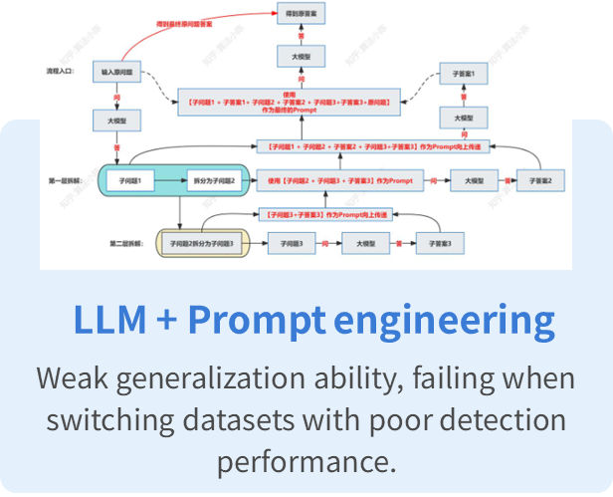
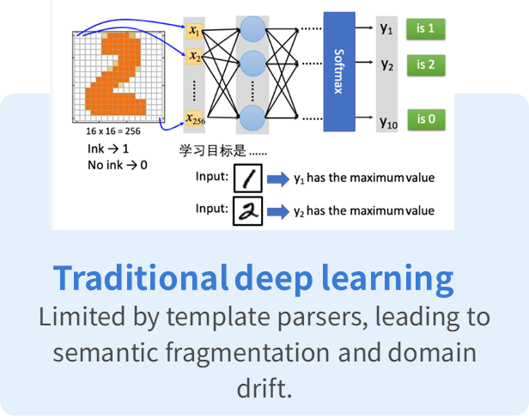
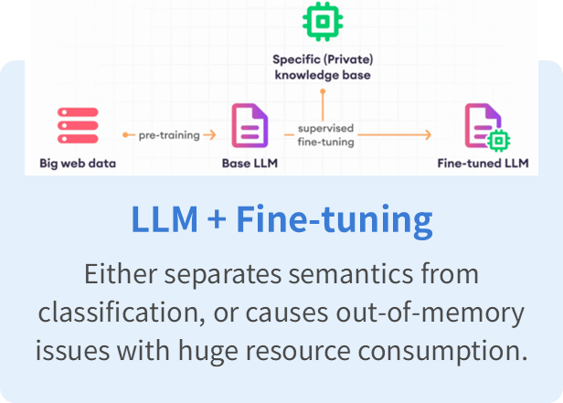
01-Clear the Bottlenecks

Slide 6
02
Core Technical Solution

Slide 7

02-Technical Challenges
Key information extraction
Leverage advanced natural language processing techniques to accurately identify and extract critical log patterns and parameters from unstructured raw data, filtering out irrelevant noise while retaining intact semantic information to support precise anomaly analysis.
Priority Ranking
Develop intelligent ranking algorithms to automatically categorize detected anomalies based on severity and urgency levels, enabling developers to prioritize critical issues and significantly optimize troubleshooting workflows.
VS Code Integration
Seamlessly embed the log anomaly detection engine into the VS Code extension ecosystem, ensuring real-time monitoring capabilities, native UI component compatibility, and non-intrusive performance within the developer's existing workflow.

Slide 8
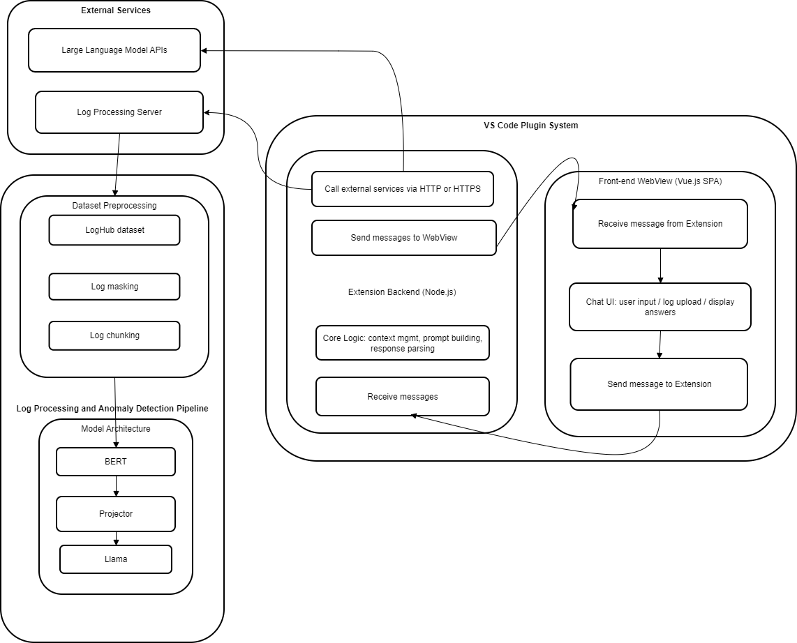

02- System Architecture
Diagram
This figure illustrates the system architecture of the VS Code plugin for anomaly log parsing based on LogLLM, which consists of three core components: left-side External Services (LLM APIs, Log Processing Server), middle VS Code Plugin System backend (Node.js-based for core logic/communication), and right front-end WebView .
A clear data flow links user requests, the log processing/anomaly detection pipeline (BERT+Projector+Llama model architecture), and result presentation, creating an efficient, secure IDE-integrated log analysis solution.

Slide 9
02- back & front
back
front
The plugin's frontend is a Vue.js single-page application embedded in the VS Code WebView, sending and receiving messages via postMessage, and updating the UI through Pinia to achieve real-time interaction.
The plugin's backend runs in the Node.js environment provided by VS Code, monitors frontend messages, processes core business logic, returns results via encapsulated interfaces, and ensures the security of sensitive information.

Slide 10
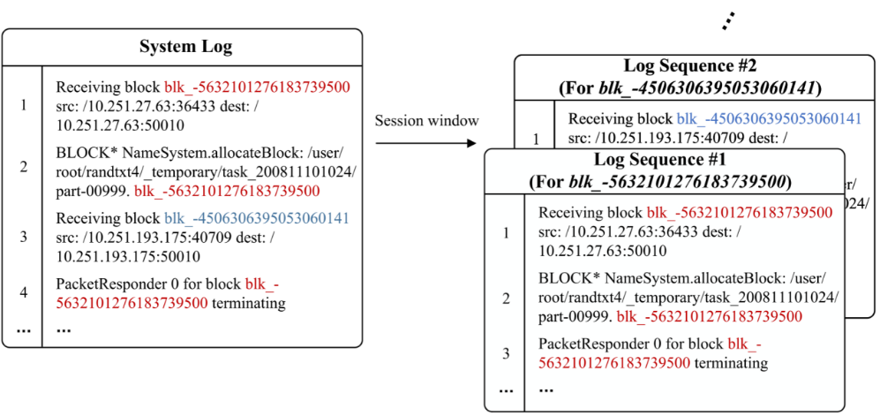
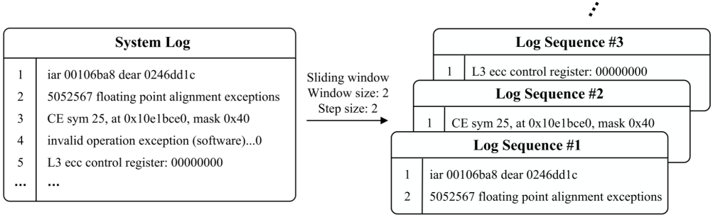
02- Log Preprocessing
Slicing Strategy
Regular Expression De-sensitization
Pattern: IP address: '\d{1,3}\.\d{1,3}\.\d{1,3}\.\d{1,3}(:\d{1,5})?', MAC address: '([0-9A-Fa-f]{2}:){11}[0-9A-Fa-f]{2}', File Path: '[a-zA-Z0-9]*[:\.]*([/\\]+[^/\\\s\[\]]+)+[/\\]*' Before: 2354412 floating point alignment exceptions ;-; 2354412 floating point alignment exceptions iar 001061e8 dear 0247015c ;-; iar 00106200 dear 0247016c ;-; iar 001061b4 dear 024701dc ciod: Received signal 15, code=0, errno=0, address=0x000001f2 10668 total interrupts. 0 critical input interrupts. 0 microseconds total spent on critical input interrupts After: <*> floating point alignment exceptions ;-; <*> floating point alignment exceptions ;-; <*> floating point alignment exceptions iar <*> dear <*> ;-; iar <*> dear <*> ;-; iar <*> dear <*> ;-; iar <*> dear <*> ;-; iar <*> dear <*> ciod: Received signal <*>, code=<*>, errno=<*>, address=<*> <*> total interrupts. <*> critical input interrupts. <*> microseconds total spent on critical input interrupts
01
02

Slide 11
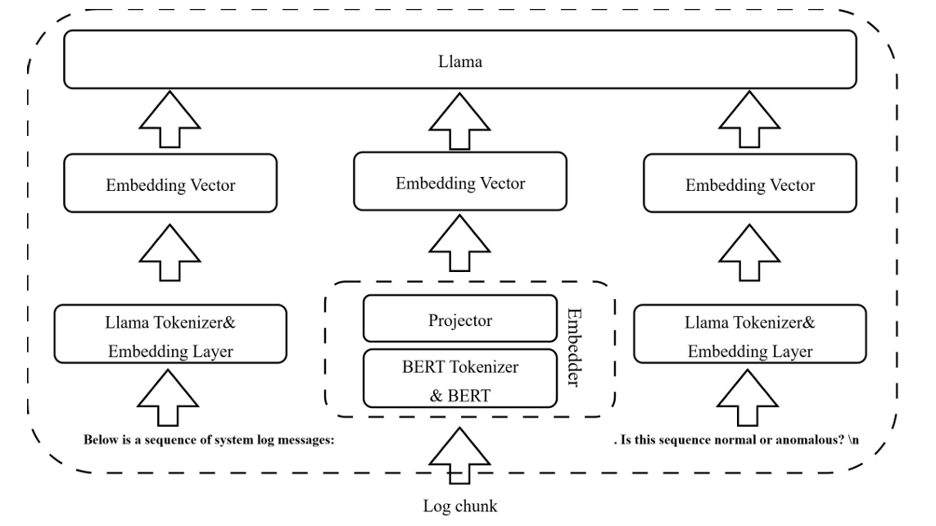
02- LogLLM Model
Datasets
LogLLM Framework
Dataset | Description | Type | Size
HDFS | Hadoop distributed file system log | Distributed system | 1.47GB
BGL | Blue Gene/L supercomputer log | Super computer | 708.76MB
Thunderbird | Thunderbird supercomputer log | Super computer | 29.60GB
Linux | Linux system log | Opreating system | 2.25MB
Apache | Web server error log | Server application | 4.90MB
Bert+Lama+Projector
Evaluation Metircs
Precision:Reduce false positives
Recall: Reduce false negatives
F1-score:Comprehensive perrformance

Slide 12

02- Frontend Frameworks and CommunicationProcesses
Communication FlowFlow
Frontend Framework
Message Sequencing
Bidirectionalcommunication viavia the VS Code APlenablescommand invocation and resultresult feedback,ensuring seamlessseamlessfrontend-backendcoordination.
The frontend adopts a WebView +Node.jsbackendarchitecture.WebView handles rendering theVue interface, while Node childprocesses host LogLLM and scoringservices.
Defined message sequences andexceptioncallbackmechanismsguarantee system stabilityandenhance user experience.

Slide 13
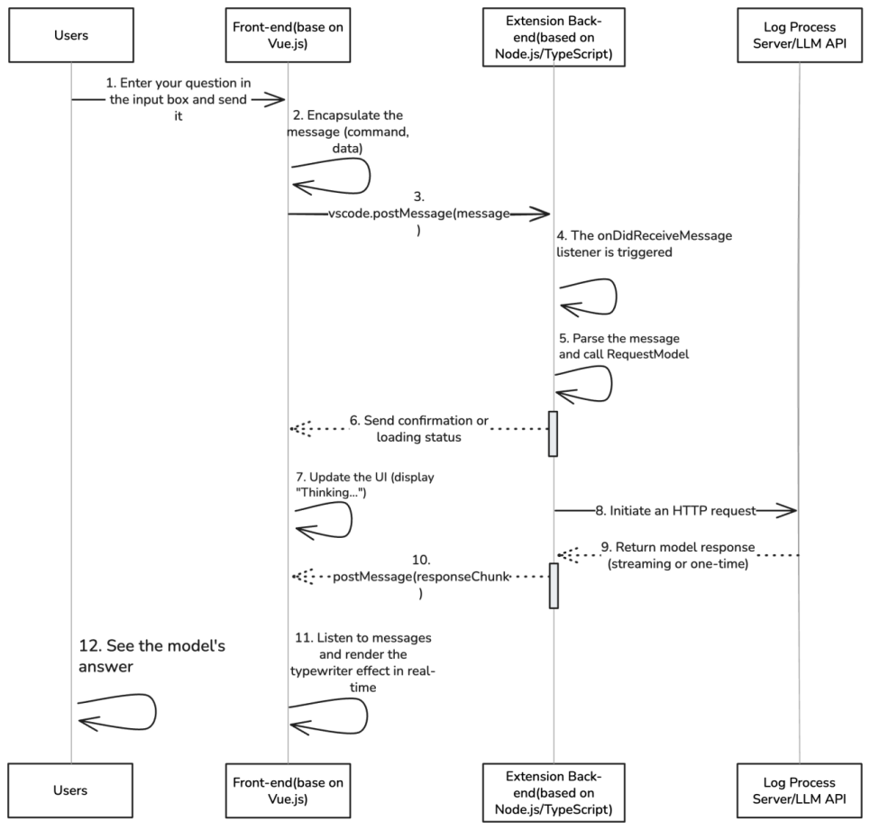
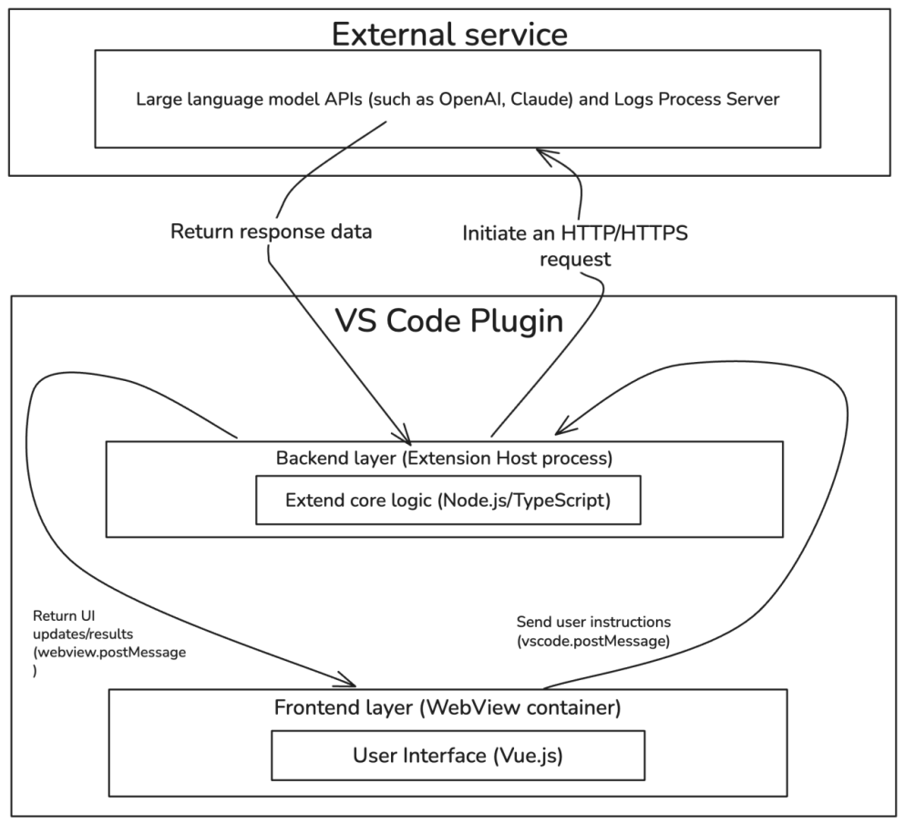
02- Front-end Implementation
Framework of Front-end
Front-end interaction

Slide 14
03
Agile Development Process

Slide 15

03-Testing Optimization and Deliverables (Sprint 1)
01
02
03
Requirement Clarification
User Stories
SpecificationDocumentation
Focus on Requirements Analysisand Architecture Design
Conduct requirement workshopsto define user stories and validatefeasibility through technicalresearch
Configure the developmentenvironment and produce therequirements specificationdocument and system architecturediagram

Slide 16
03-Frontend and Backend Developmentwith ModelIntegration (Sprint 2)
Frontend and Backend Development
Frontend and Backend DevelopmentFrontend and Backend Development, encompassing backend servicesetup and LogLLM model integration,frontend interfaceimplementation, and frontend-backend data communication integration
Model Integration and Delivery
Includes refinement of features such as custom prompts, delivering afunctional plugin prototype.

Slide 17
03- Testing Optimization and Deliverables (Sprint 3)
03
02
01
Deliverables
OptimizationandImprovements
Multi-DimensionalTesting
Compiled test reports and usermanuals, delivering the v1.0plugin package.
Fixed memory leaks and longlong log blocking issues. AddedAdded a dark theme andkeyboard shortcuts to enhanceenhance user experience.
Conductfunctional,performance,security,andcompatibility testing to ensuresystem stability and reliability.

Slide 18
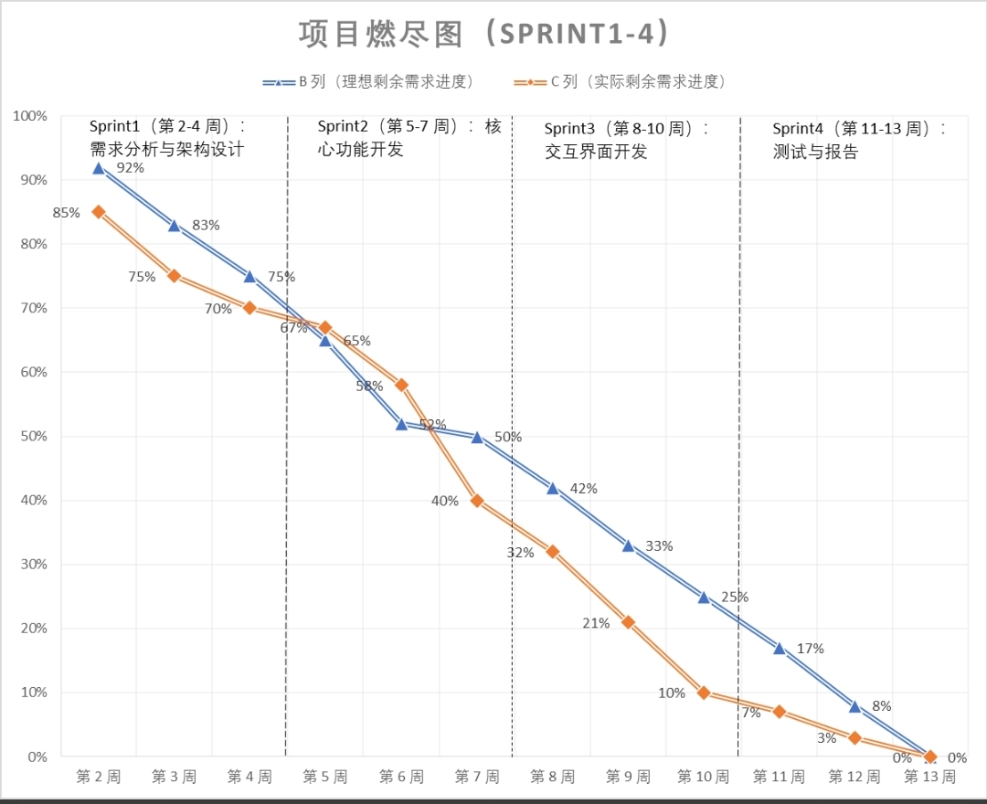
03- Burndown Chart
Burndown Chart Display
Burndown Chart DisplayDisplaying Sprint 1-4 burndowncharts, with the vertical axisrepresenting remaining Story Pointsand the horizontal axis showingweeks.The curve exhibits a steadydecline.

Slide 19
04
Testing and Experimental Results

Slide 20
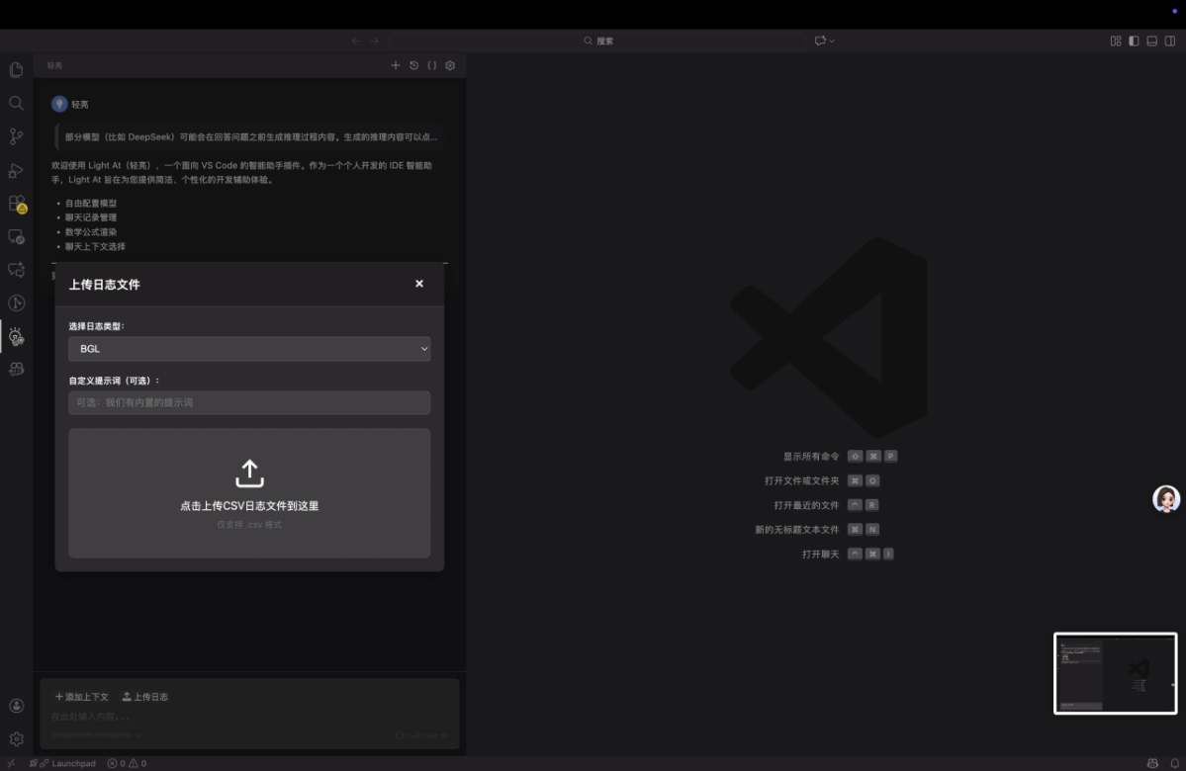
04- User Experience Flow- 1
Log File Upload
Interface
Display the log file uploadinterface, highlighting itszero-configuration setup forquick access, enabling usersto import logs rapidly.

Slide 21
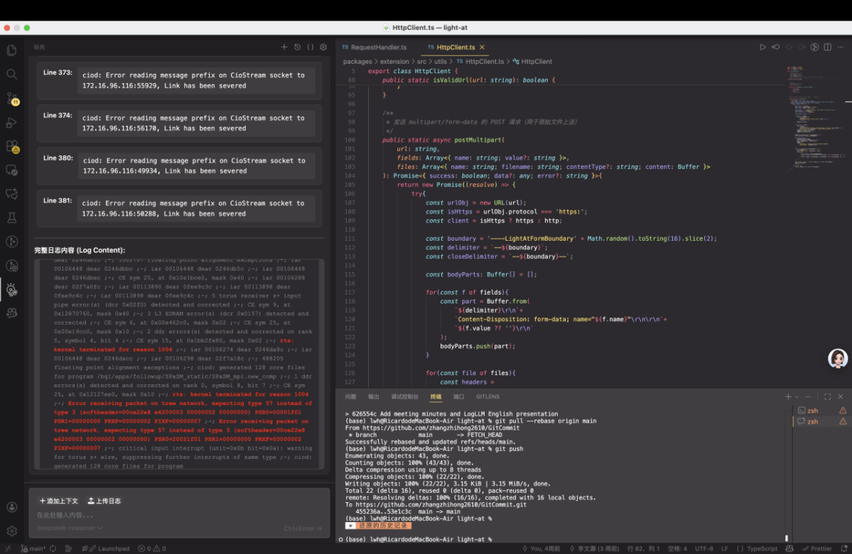
04- User Experience Flow- 2
Highlighted
Abnormal Content
Display abnormalcontent with ahighlighted effect tohelp users quicklypinpoint issues andimprovetroubleshootingefficiency.

Slide 22
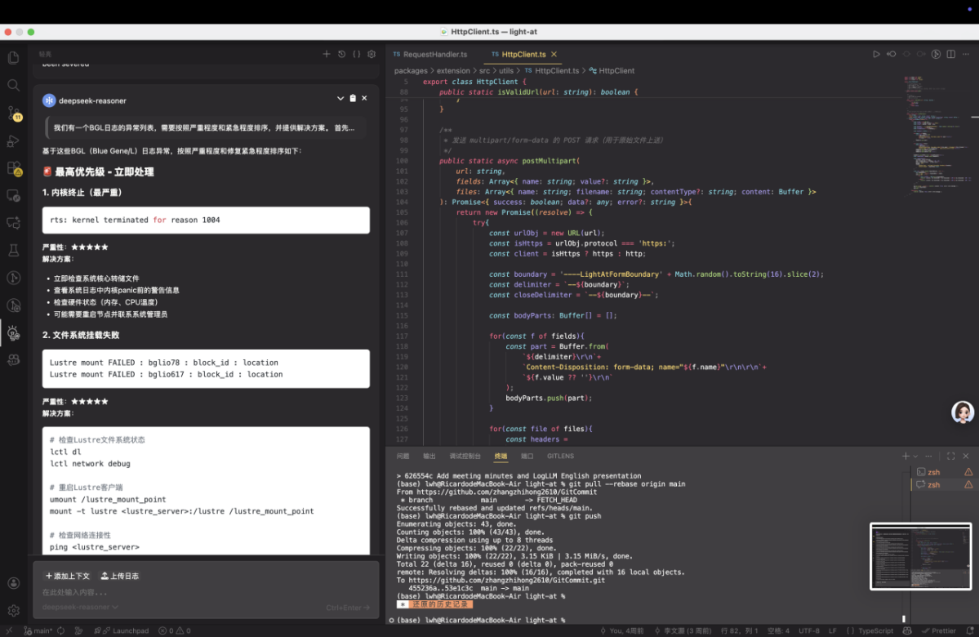
04- User Experience Flow- 3
AI Model’s
In-depth Analysis
Report on
Log Anomalies
Solutions prioritized byissue urgency. Present Al in-depthanalysisreportshighlightingtraceableconclusionstoproviderobust support for problemresolution.

Slide 23



04-测试
Test Preparation
Test Case Execution
Defect Management
Establish a multi-environmenttesting matrix, prepare test dataand tools, organize tester training,and lay the foundation for end-to-end testing
Execute test cases according topriority: PO(Blocking)→P1(HighPriority)→P2 (Medium Priority)P3(Low Priority). Documentexecution results and defectinformation in detail.
Record defects in Jira (including(including reproduction steps,expected/actual results,andscreenshots),track resolutionprogress, and conduct regressionregression testing for resolveddefects

Slide 24
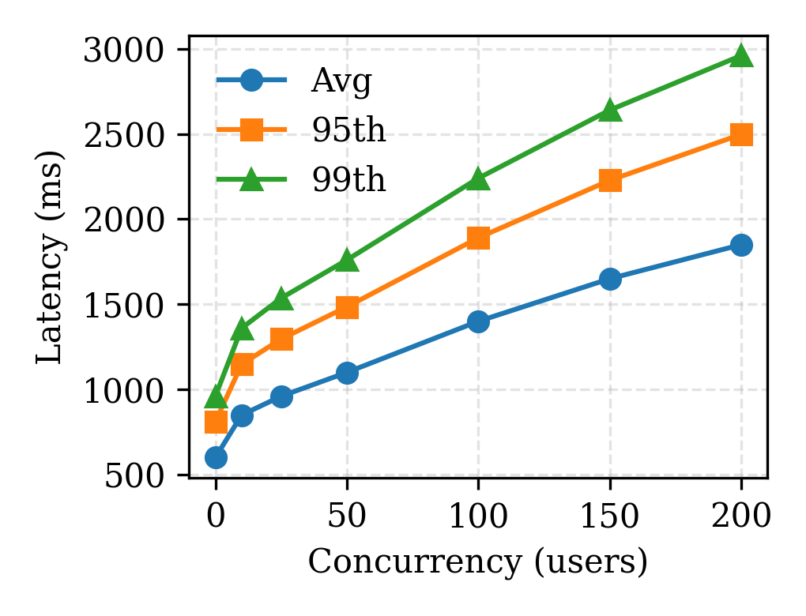
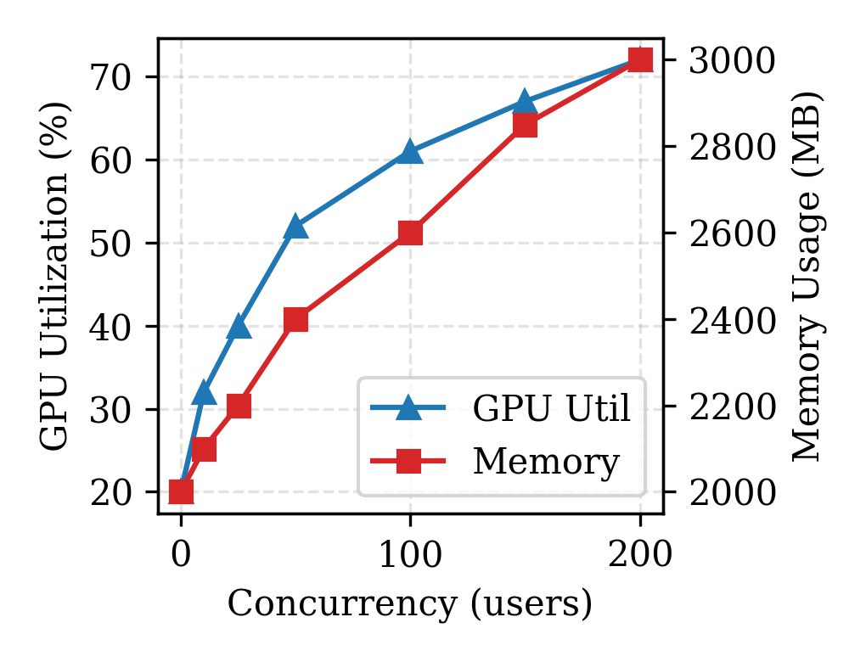
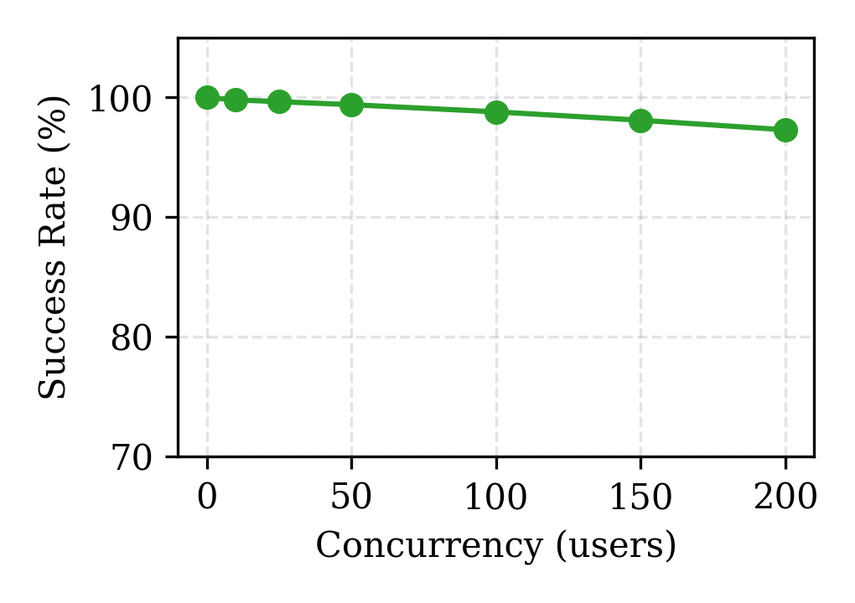
04- Testing Result
Latency Performance
Resource Utilization
Success Rate
GPU usage (>70%) and memory (3000MB) grow with load at 200 concurrent users.
Avg/95th/99th latency rises with 0-200 concurrent users, staying within acceptable limits.
Request success rate remains above 99% (near 100%) across 0-200 concurrent users.

Slide 25
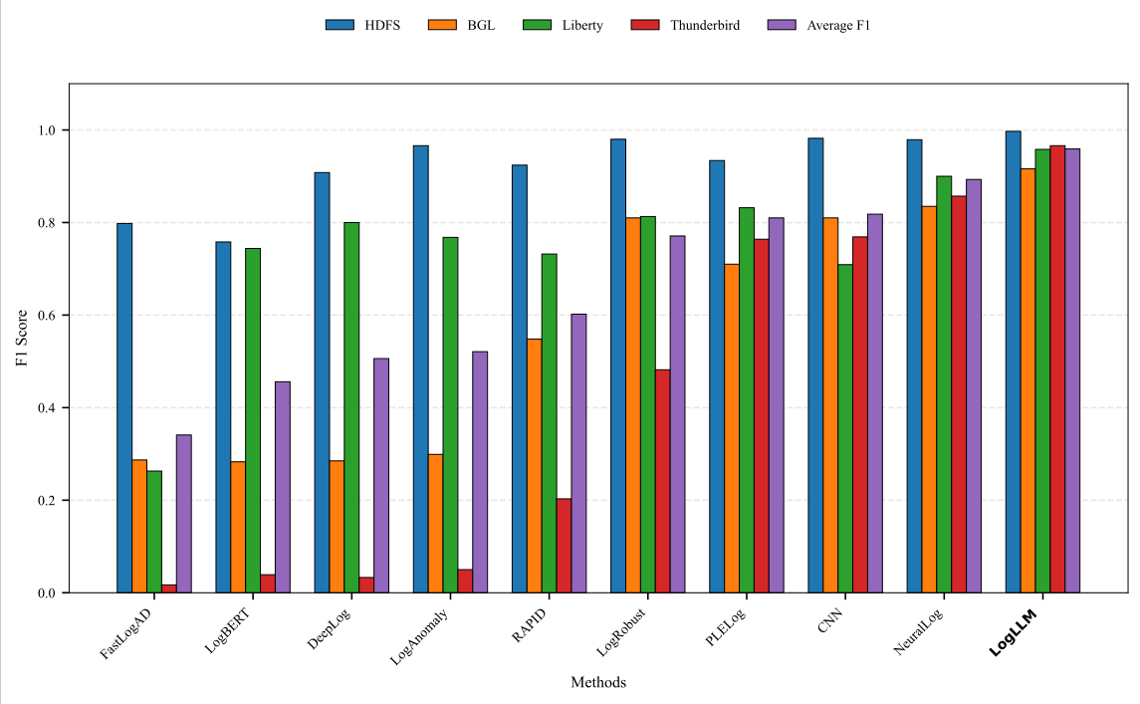
04- Testing Result: F1 Score Comparison
This chart compares the F1 scores of multiple log analysis methods (e.g., FastLogD, LogLLM). LogLLM (rightmost) achieves the highest F1 score (near 1.0), outperforming other methods (e.g., HDFS, IGL) and exceeding the average F1 level significantly.

Slide 26
05
Project Outcomes and Future Work

Slide 27
05-Process, Tech, Tools & Team Outcomes
Process Outcomes
Technical Outcomes
Tool Outcomes
Team Outcomes
Adopted Agile Scrum framework (12 weeks, 3 Sprints) to standardize workflows (requirements gathering, prototyping, etc.). Sprint task completion rate exceeded 90%, aligned with burndown milestones to ensure on-time delivery.
Key innovations: ① On-premises LogLLM deployment (eliminated 3rd-party API dependency); ② Dynamic privacy masking (100% accuracy for sensitive data); ③ Anomaly priority ranking with solutions.
Completed VS Code plugin: Supports unlimited log length (streaming/chunking), parses 8 anomaly types, 92.3% recognition accuracy, and faster response than tools like SigLLM.
Cross-functional collaboration (front-end/back-end/algorithm teams) with 3 best practices: modular architecture, standardized API communication, log edge-case test design.

Slide 28

05- Competitive Analysis
Advantages Over Existing Solutions
Our plugin offers AI-powered anomaly detection, real-time analysis, semantic understanding, and native VS Code integration. These features set it apart from traditional tools.

Slide 29
05- Project Impact & Future Work
Immediate Impact
Future Enhancements
The plugin reduces debugging time by 60% and enables proactive system monitoring. This immediate impact enhances developer productivity and system reliability.
Future work includes multi-language log support, cloud integration, team collaboration features, and advanced visualization. These enhancements aim to expand the plugin's capabilities.

Slide 30
05- Team Reflection & Learnings
Technical Learnings
Collaboration
Project Management
Innovation
The team gained deep experience in optimizing deep learning models for efficient deployment. This technical expertise will be valuable for future projects.
Agile practices improved cross-functional coordination within the team. Effective collaboration ensured smooth progress throughout the project.
Balancing scope with timeline constraints was a key lesson in project management. This experience will inform future project planning and execution.
Transitioning academic research into a production-ready tool highlighted the importance of iterative development and user feedback. This process fostered innovation.

Slide 31
THANKS
Goup: GitCommit
日期：2025/11/19

